Slide 1




DEMAND FORECASTING FOR E-COMMERCE
19/07/2024

Slide 2
CONTENTS
Problem statement
Data Introduction
Data Overview
Feature Engineering
Linear Regression Impact
Visualisation
Time Series Analysis
Demand Forecasting Models
Comparison of All Forecasting Models
Conclusion

Slide 3
PROBLEM STATEMENT
In the competitive e-commerce landscape, accurate demand forecasting is crucial. This project aims to develop a sophisticated model using historical sales data and Google Analytics KPIs, like Google clicks and Facebook impressions, to predict future product demand and understand customer behavior.
Develop Demand Forecasting Model
Identify Trends and Seasonal Patterns
Build Predictive Models

Slide 4
DATA INTRODUCTION
We have three datasets:
1. ProductA_google_clicks.xlsx: Day Index, Google Clicks
2. ProductA_fb_impressions.xlsx: Day Index, Facebook Impressions
3. ProductA.xlsx: Day Index, Quantity Sales
These were merged using a left join to create merged_df.xlsx with 212 rows and 4 columns: Day Index, Quantity, Clicks, and Impressions.
- Target Variable: Quantity (dependent)
- Independent Variables: Clicks, Impressions

Slide 5
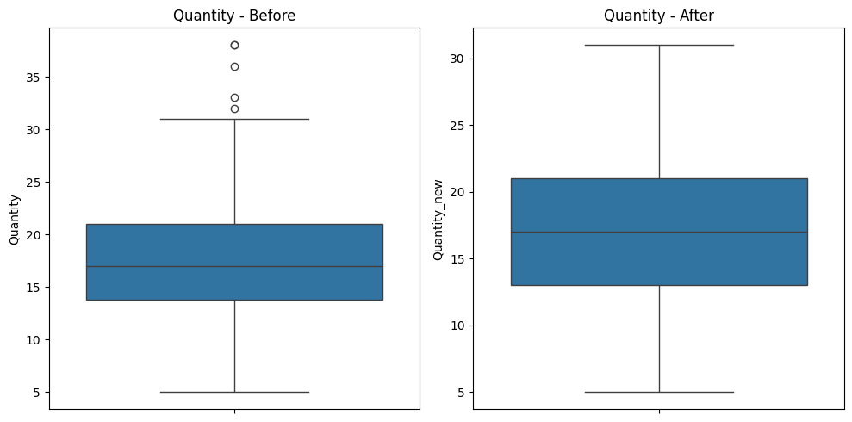
DATA OVERVIEW
Checking Missing Values and Dropping Duplicates:
No missing values in 'Quantity', 'Clicks', and 'Impressions' columns.
No duplicates found; no rows were dropped.
Analysis of Outliers and Replacement:
Outliers in 'Quantity' were replaced with the 95th percentile value.
Box plots show 'Quantity' data before and after outlier removal. Median stays at 16, range narrows from 5-30 to 5-25, eliminating extreme values and improving forecast accuracy.

Slide 6

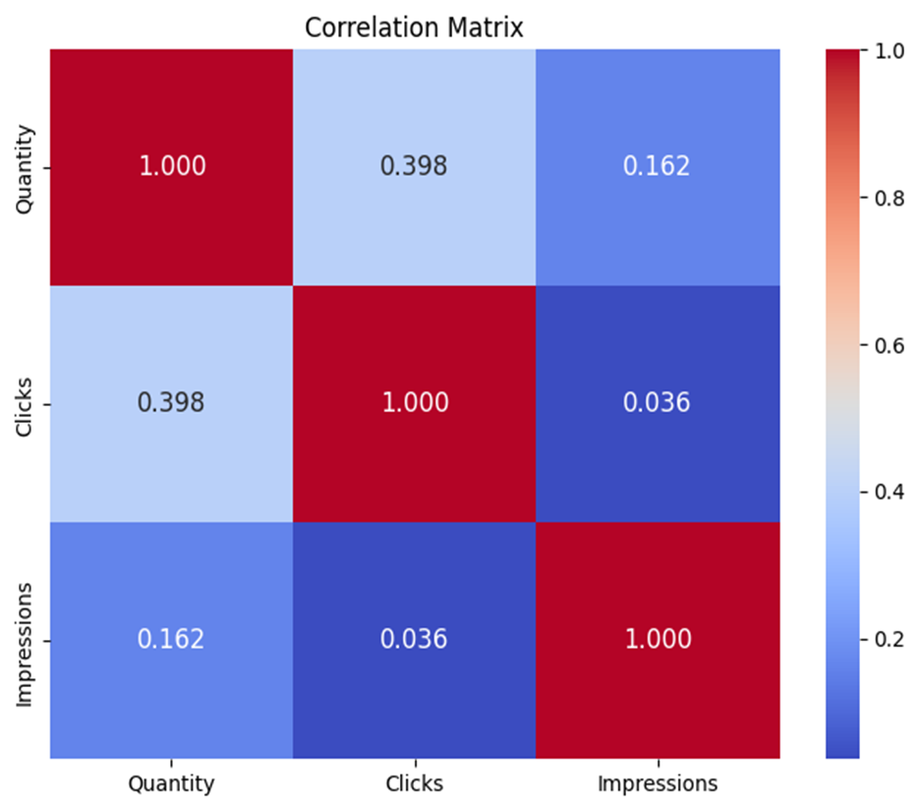
FEATURE ENGINEERING
Several additional features were engineered to enhance the dataset, aiming to improve predictive capabilities by incorporating contextual influences on the target variable.
After feature engineering, the variables are:
1. Date
2. Quantity
3. Clicks
4. Impressions
5. Day
6. Month
7. Year
8. Day of Week
9. Day of Year
10. Week of Year
11. Month_12
12. Month_1
13. Month_2
14. Month_3
15. Month_4
16. Month_5
17. Month_6
18. Day of Week Sin
19. Day of Week Cos
20. Is Holiday
21. Is Month Start
22. Is Month End
23. Is Quarter Start
24. Is Quarter End
25. Is Year Start
26. Is Year End
Quantity and clicks have a moderate positive correlation (0.398).
Impressions show weak correlation with both quantity and clicks.

Slide 7
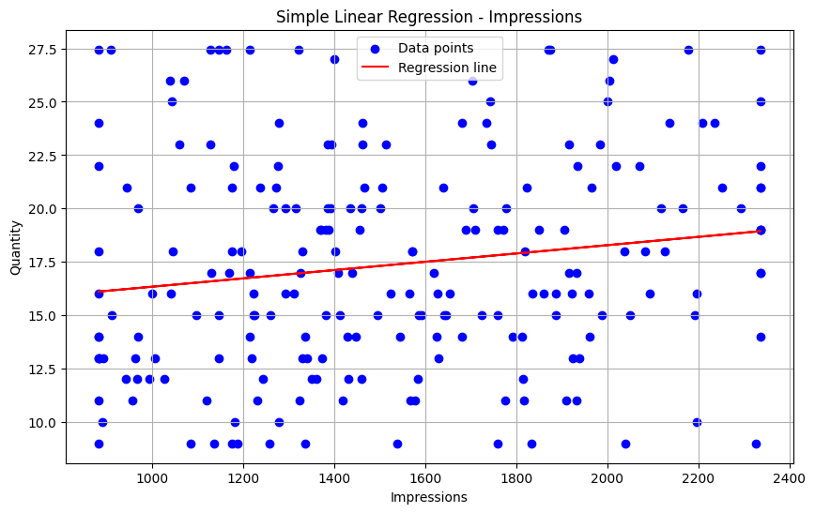
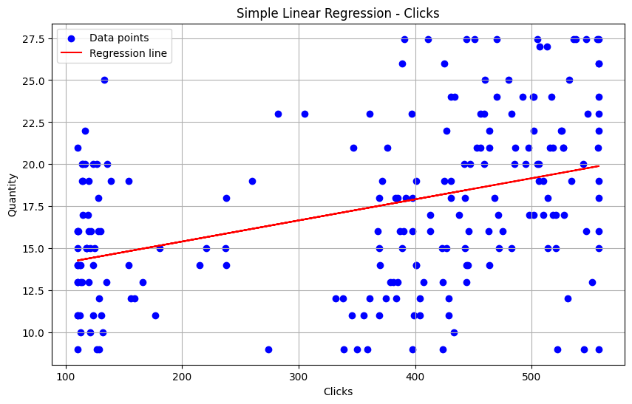
LINEAR REGRESSION IMPACT
Weak model fit indicates a positive correlation between Quantity and Impressions.
Moderate fit shows Clicks positively correlate with Quantity_new.

Slide 8
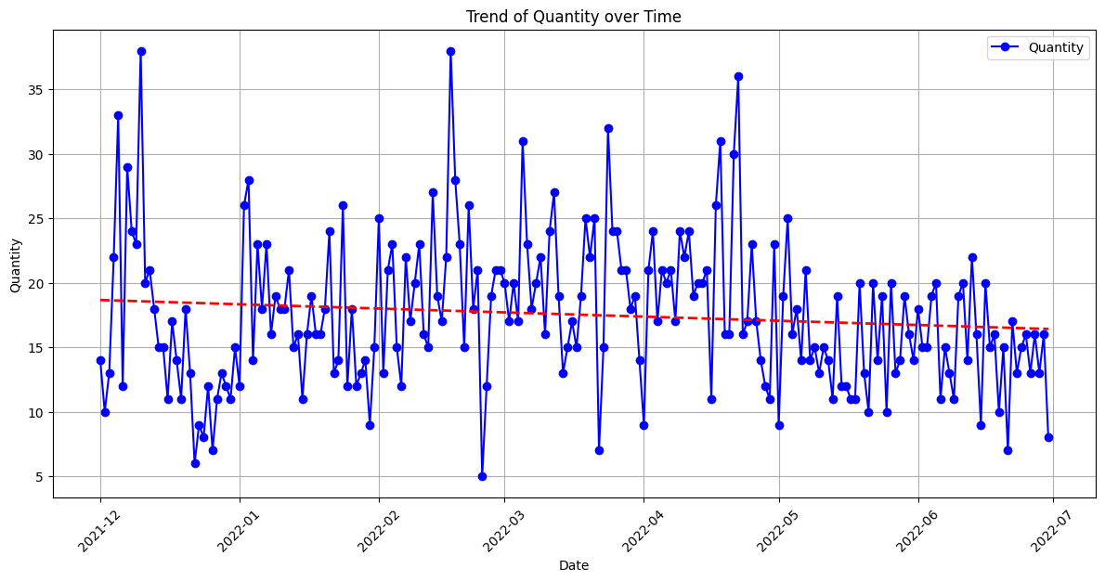
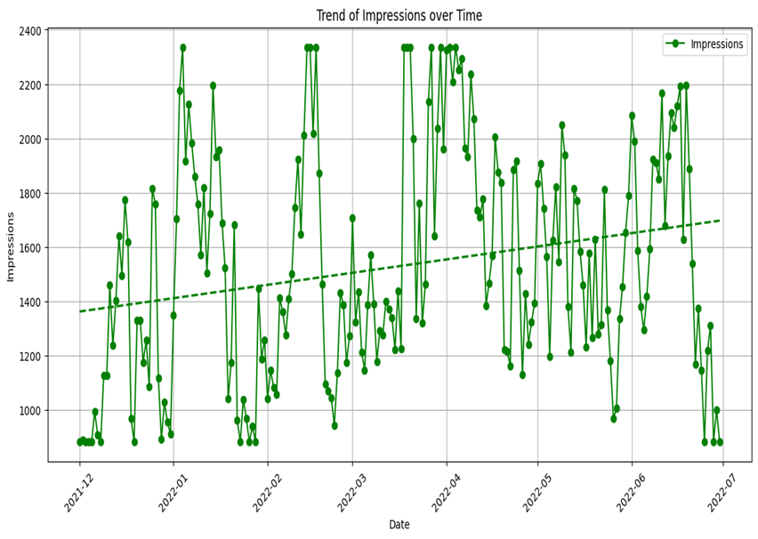
Weak fit, insignificant predictor, minor declining trend in Quantity.
Weak fit with a significant predictor, indicating an upward trend in Impressions.

Slide 9
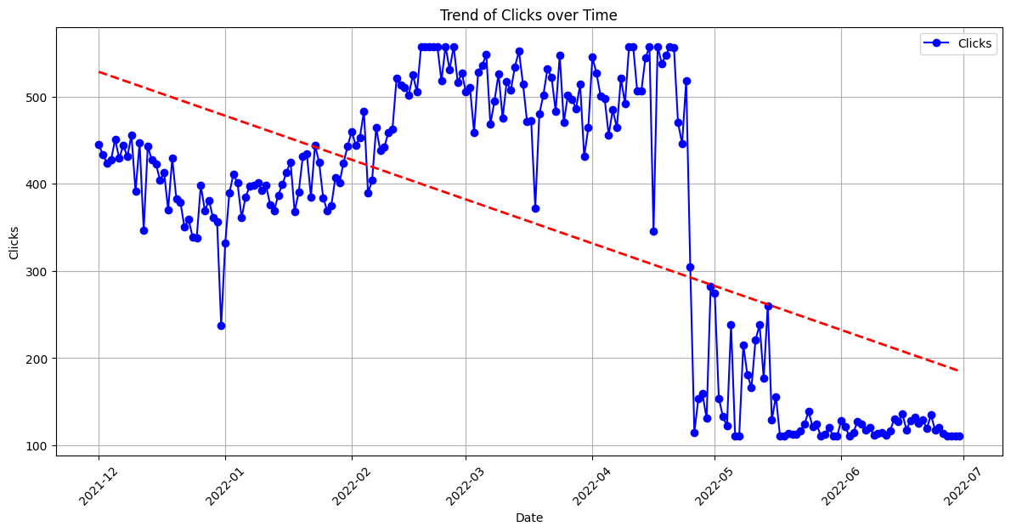
Moderate fit with significant predictors, indicating a downward trend in Clicks.

Slide 10
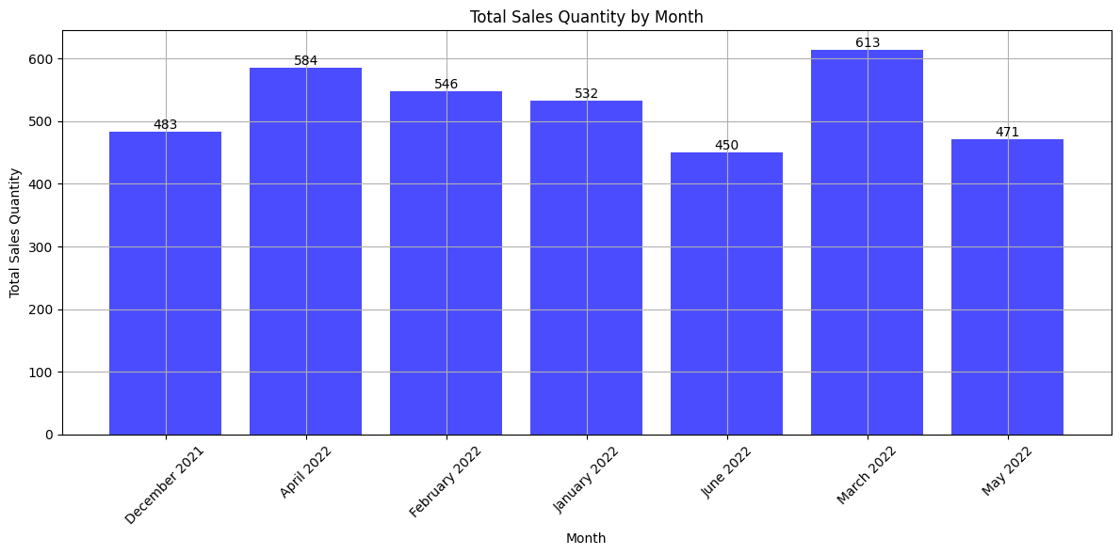
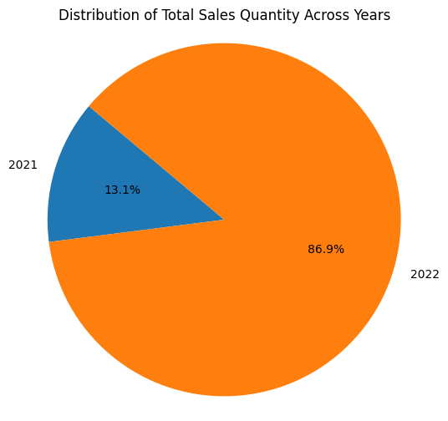
VISUALISATION
MONTHLY SALES
YEARLY SALES
Sales Ranking:
1. March 2022 [613 sales]
2. April 2022 [584 sales]
3. February 2022 [546 sales]
4. January 2022 [532 sales]
5. December 2021 [483 sales]
6. May 2022 [471 sales]
7. June 2022 [450]
This analysis may be inaccurate due to the limited data: 2021 includes only one month (December), while 2022 has six months of data (January to June).

Slide 11
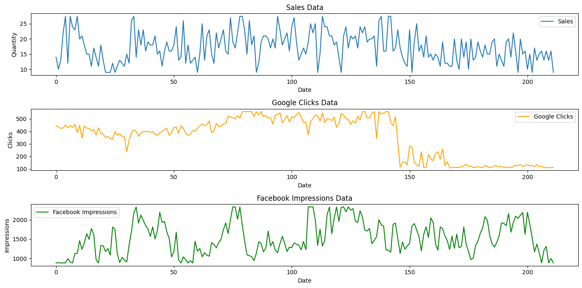
TIME SERIES ANALYSIS
STATIONARITY AND TREND
1. Sales Data:
- ADF: -4.38, p-value: 0.0003.
- Stationary.
2. Google Clicks Data:
- ADF: -0.95, p-value: 0.77.
- Not stationary.
3. Facebook Impressions Data:
- ADF: -5.49, p-value: 0.
- Stationary.

Slide 12
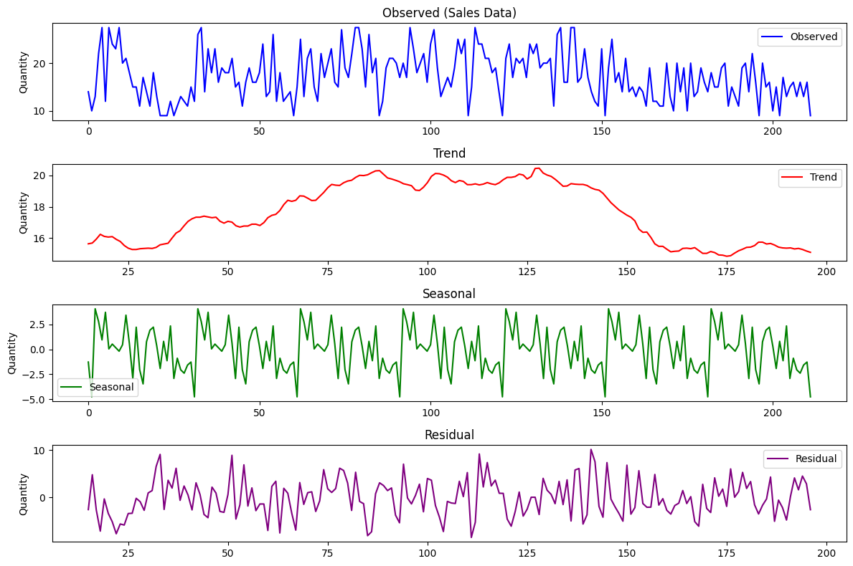
SEASONALITY
1. Observed:
- Raw sales data show significant fluctuations with no strong seasonality or clear trend.
2. Trend:
- Indicates a slight initial decline, followed by an increase, and then another decline, suggesting changing sales patterns over time.
3. Seasonal:
- Shows regular, small seasonal effects around zero, indicating minor seasonal impacts on sales.
4. Residual:
- High volatility with no clear pattern, implying other external factors or randomness affecting sales.

Slide 13



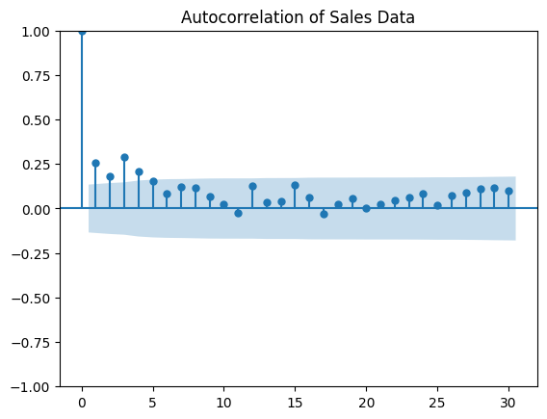
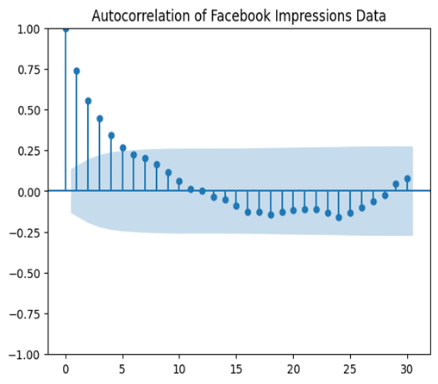
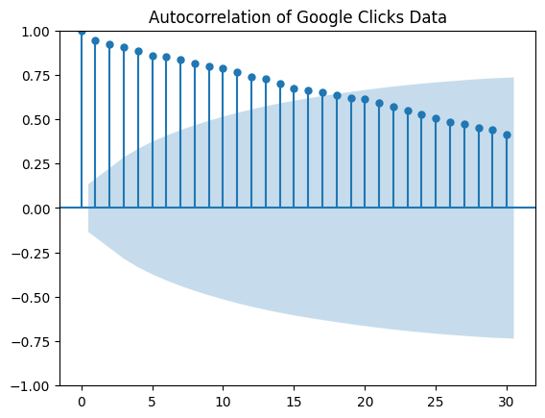
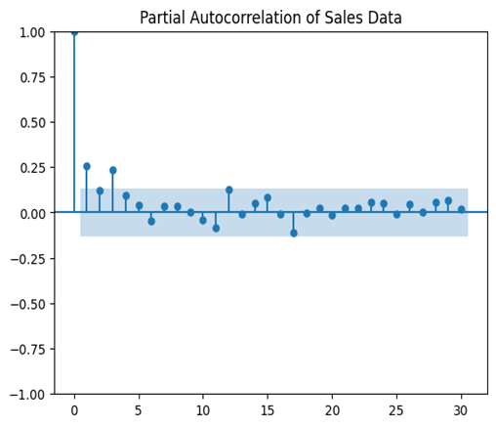
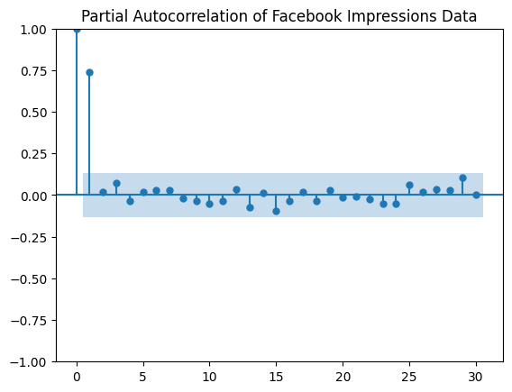
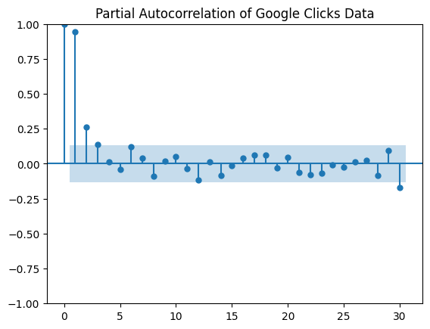
AUTOCORRELATION(ACF) AND PARTIAL AUTOCORRELATION(PACF)
ACF Plot:
- Significant at lag 1, quickly becomes insignificant.
PACF Plot:
- Significant at lag 1, quickly falls within bounds.
ACF Plot:
- Significant positive autocorrelation up to lag 10, then mostly negative.
PACF Plot:
- Significant at lags 1, 2, and 3; primarily explained by the first few lags.
ACF Plot:
- Strong, slowly decaying autocorrelation.
PACF Plot:
- Significant spike at lag 1, smaller subsequent spikes.

Slide 14
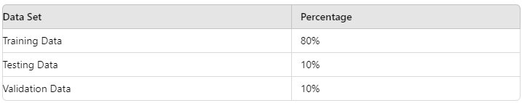
DEMAND FORECASTING MODELS
MODEL TRAINING AND EVALUATION
The data is split in the following ratio
METRICS CONSIDERED:
RMSE (Root Mean Square Error)
MAE (Mean Absolute Error)
MAPE (Mean Absolute Percentage Error)
R² (Coefficient of Determination)
Adjusted R²
MODEL PARAMETERS:
p: 1 d: 0 q: 1
The values for p ,d, and q were determined using the ACF and PACF plots.
The exogenous variables used include: 'Clicks', 'Impressions', 'Day', 'Year', 'Month_December', 'Month_February', 'Month_January', 'Month_March', and 'Month_May'.

Slide 15
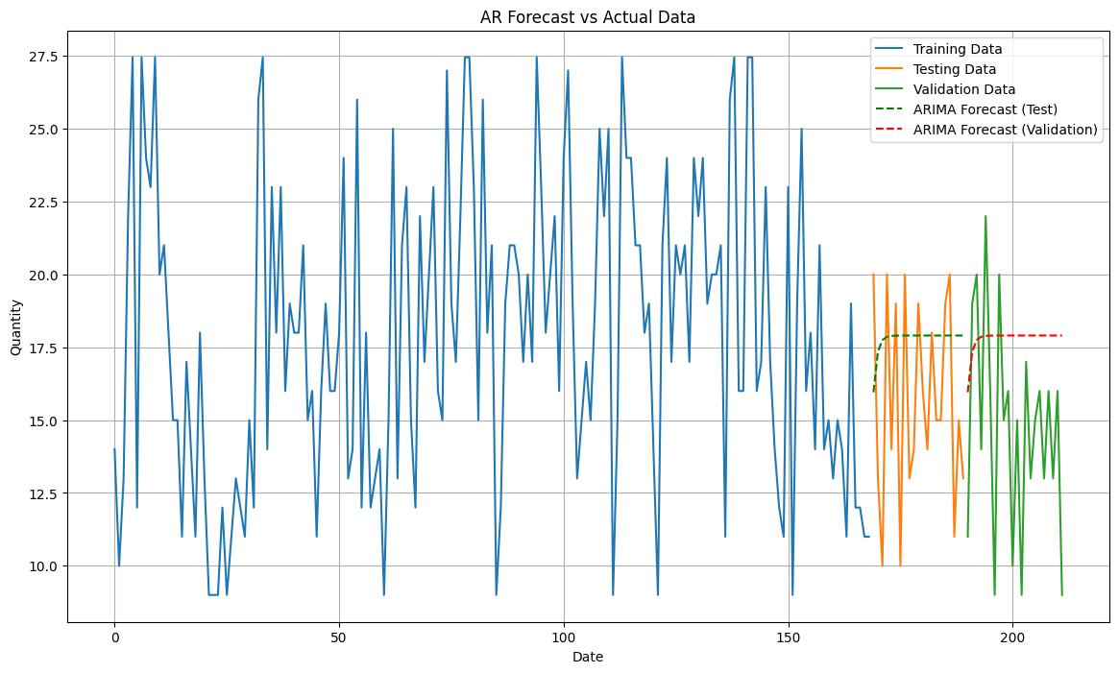
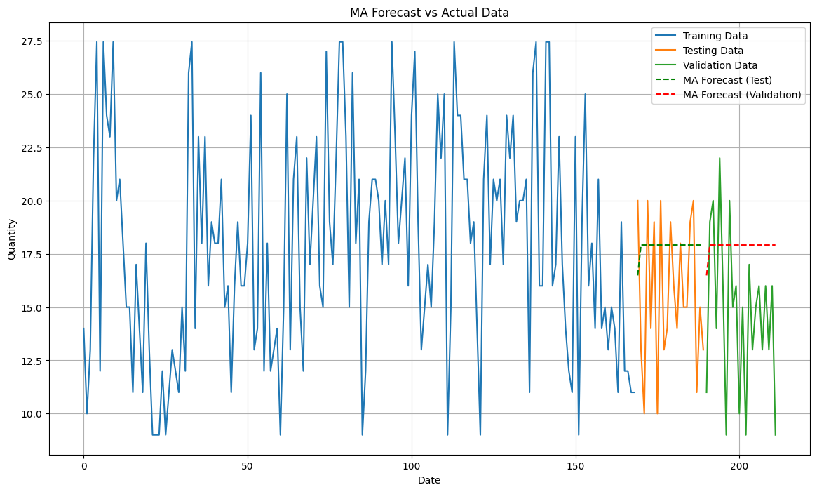
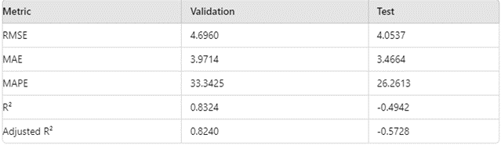
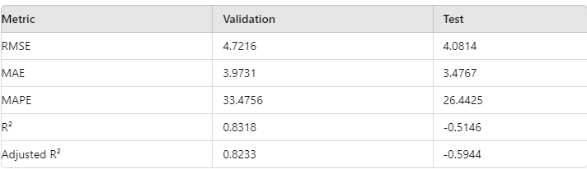
AR MODEL
MA MODEL
The AR model performs better on the test data compared to the validation data, indicating it may not generalize as well outside the test set.
The MA model shows similar results to the AR model, with better performance on the test data compared to the validation data.

Slide 16
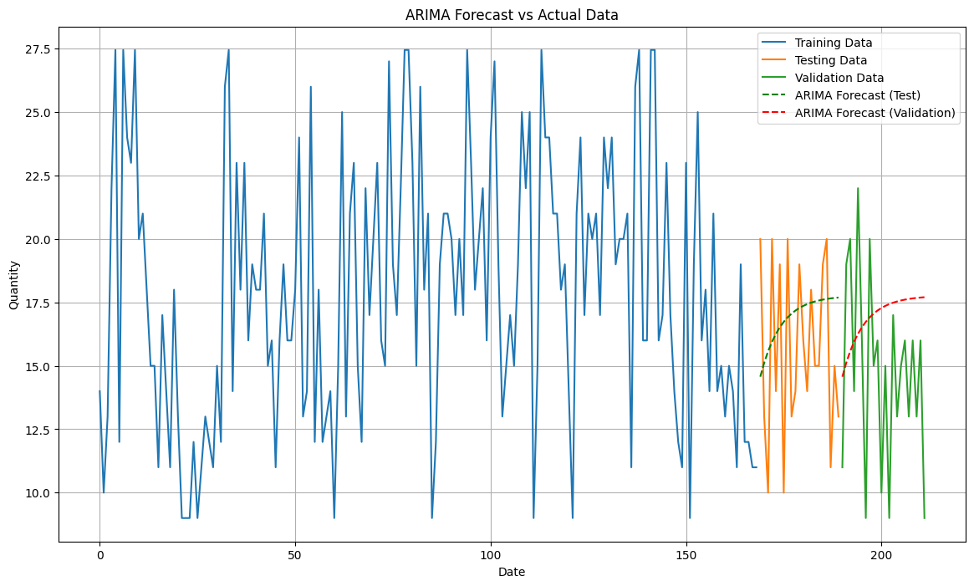
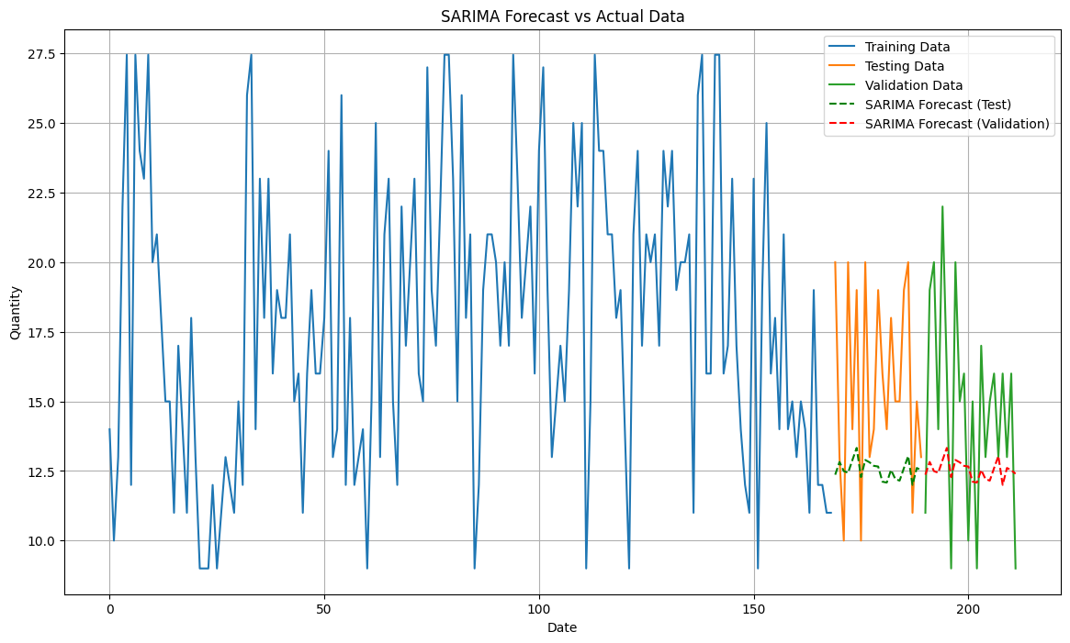
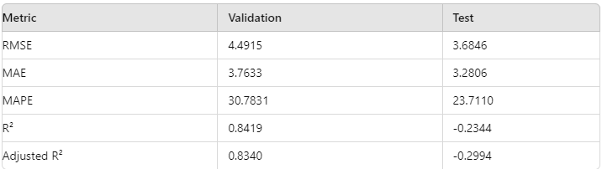
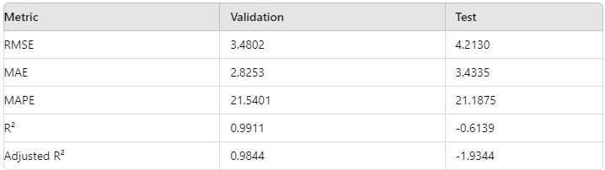
ARIMA MODEL
SARIMA MODEL
The ARIMA model (1, 0, 1) performs better on test data than validation data, indicating performance variability.
The SARIMA model (1, 0, 1)(1, 0, 1, 12) performs better on validation data than test data, indicating good generalization.

Slide 17
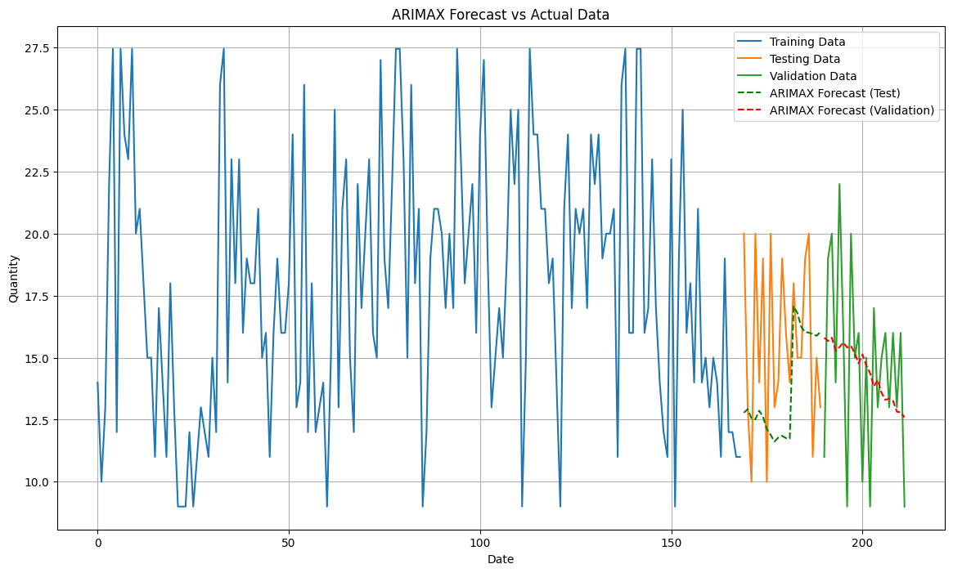
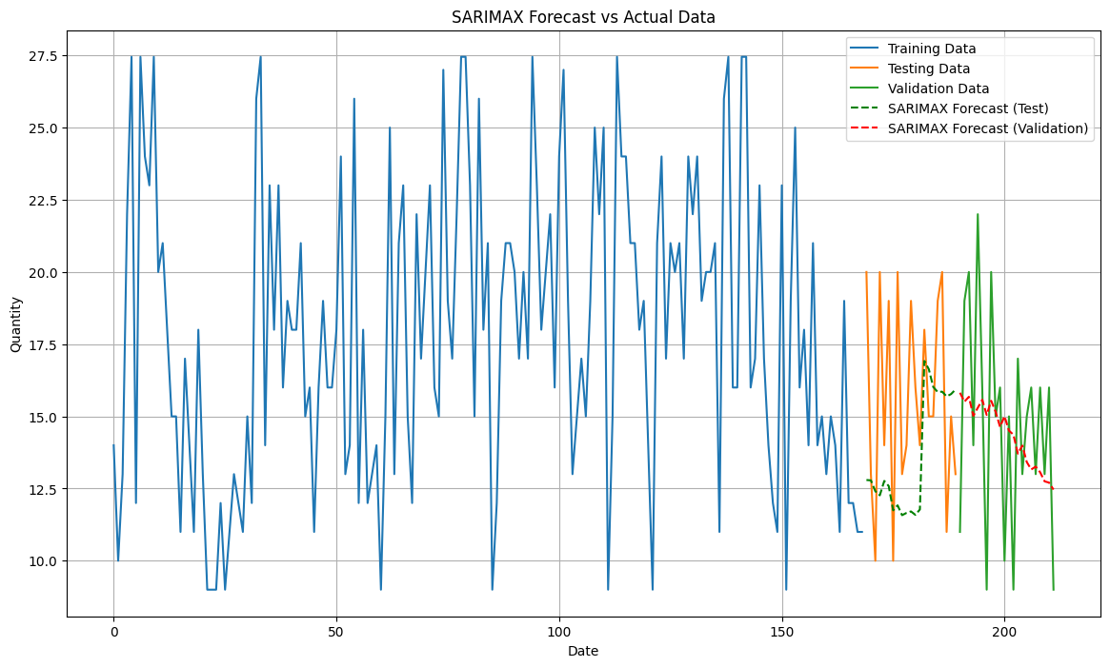
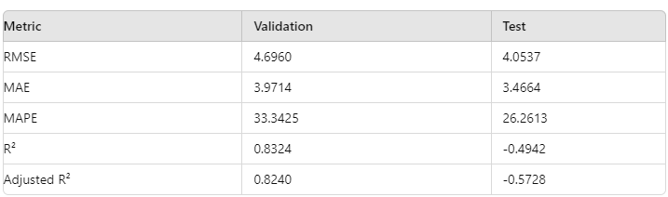
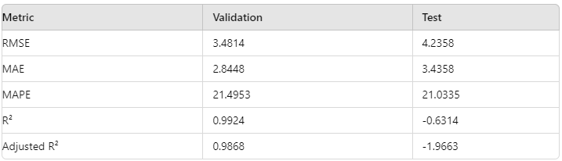
ARIMAX MODEL
SARIMAX MODEL
The ARIMAX model performs slightly better on the validation data compared to the test data.
The SARIMAX model performs better on the validation data compared to the test data, indicating good generalization.

Slide 18
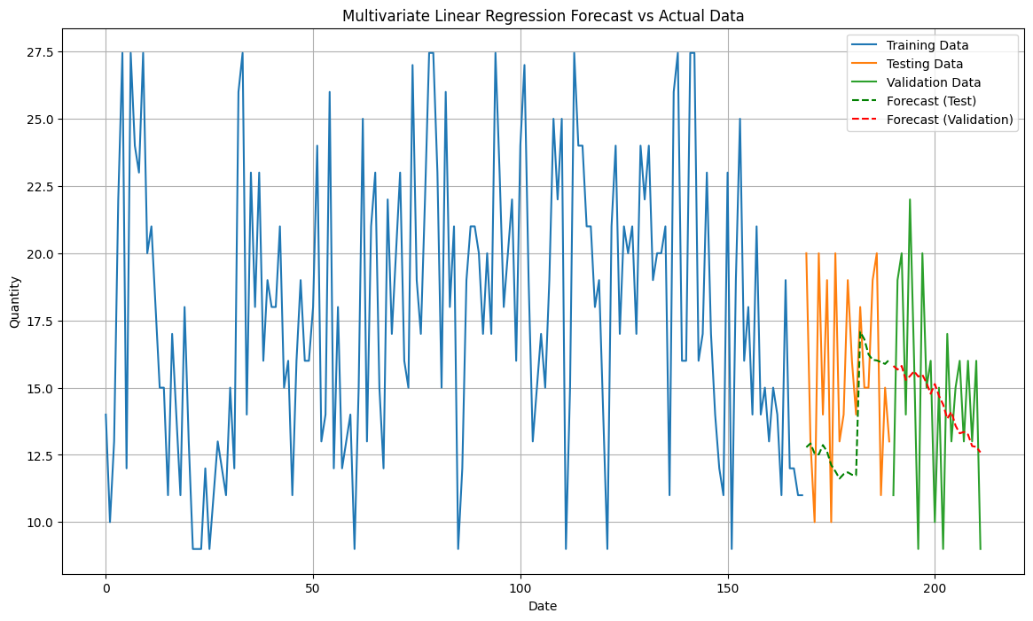

MULTIVARIATE LINEAR REGRESSION MODEL
The Linear Regression model shows poor fit with low R² and high RMSE in both test and validation data, indicating insufficient explanation of data variability.

Slide 19

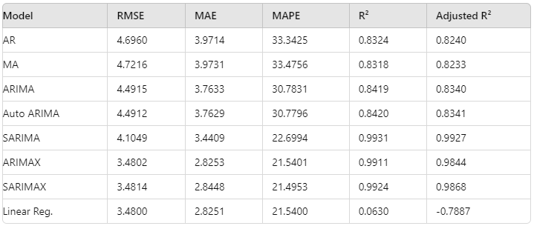
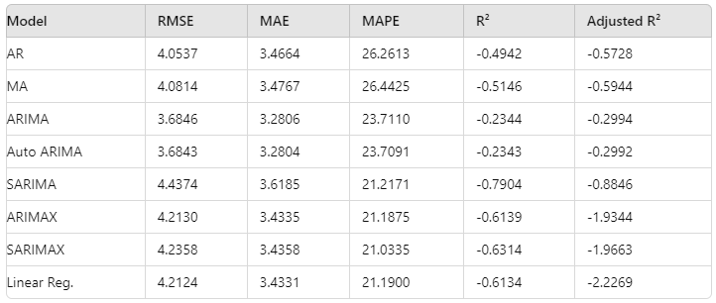
COMPARISION OF MODELS
VALIDATION DATA VALUES
TEST DATA VALUES
Best Model: SARIMA leads with R² (0.9931) and Adjusted R² (0.9927); ARIMAX is close with R² (0.9911).
Error Metrics: ARIMAX has the lowest RMSE (3.4802) and MAE (2.8253). Linear Regression shows low metrics but poor fit with low R².
Robustness: Auto ARIMA and ARIMA perform well but not as strongly as SARIMA and ARIMAX.
Performance Drop: Most models show reduced performance and negative R², indicating potential overfitting.
Relative Performance: ARIMA and Auto ARIMA have the best RMSE (3.6846 and 3.6843); SARIMA's RMSE is higher (4.4374).
Linear Regression: Low RMSE (4.2124) but negative R² reflects ineffective pattern capture.

Slide 20
CONCLUSION
The ARIMAX model is considered the best choice for forecasting due to:
- Lowest RMSE: 3.4802
- Lowest MAE: 2.8253
- High R²: 0.9911, indicating effective variance explanation.
While the SARIMA model has a higher R² (0.9931), the ARIMAX model captures the relationship with exogenous variables more effectively.
Overall, ARIMAX is preferred for its accuracy and ability to incorporate additional predictors.

Slide 21
Thank You
For any queries sudharshan3512@gmail.com

Slide 22
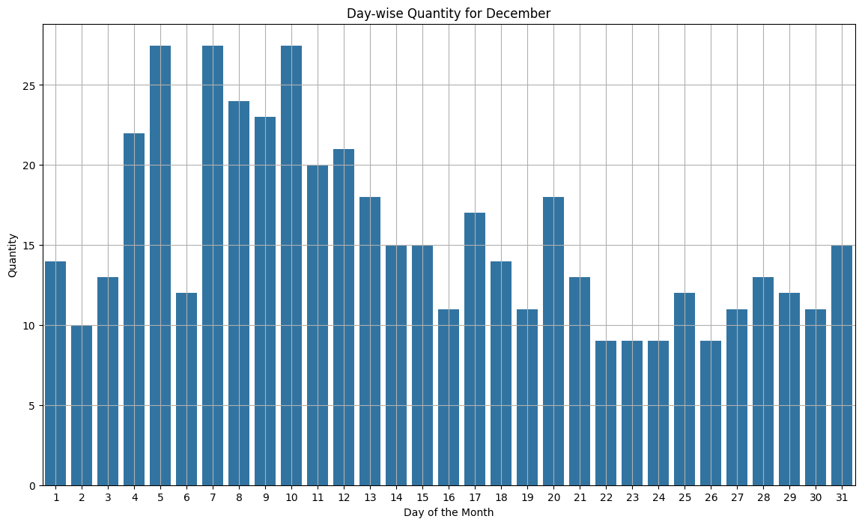
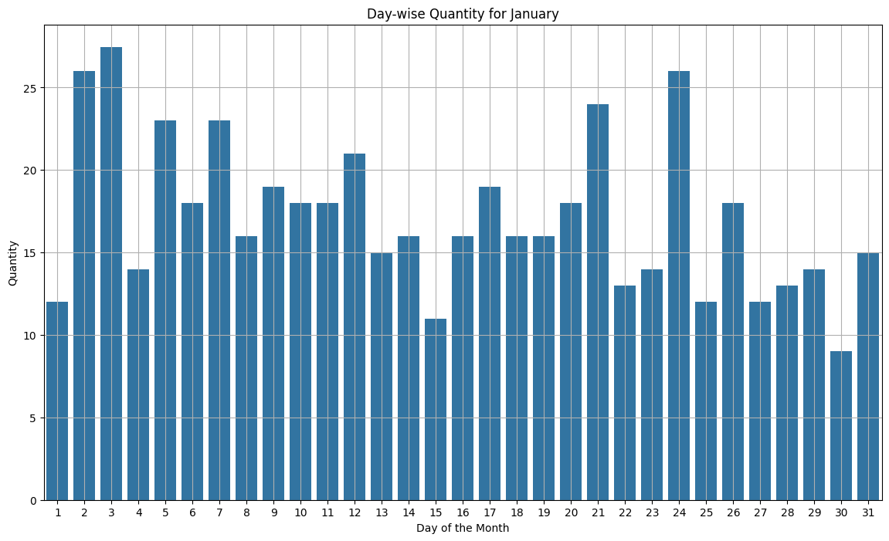
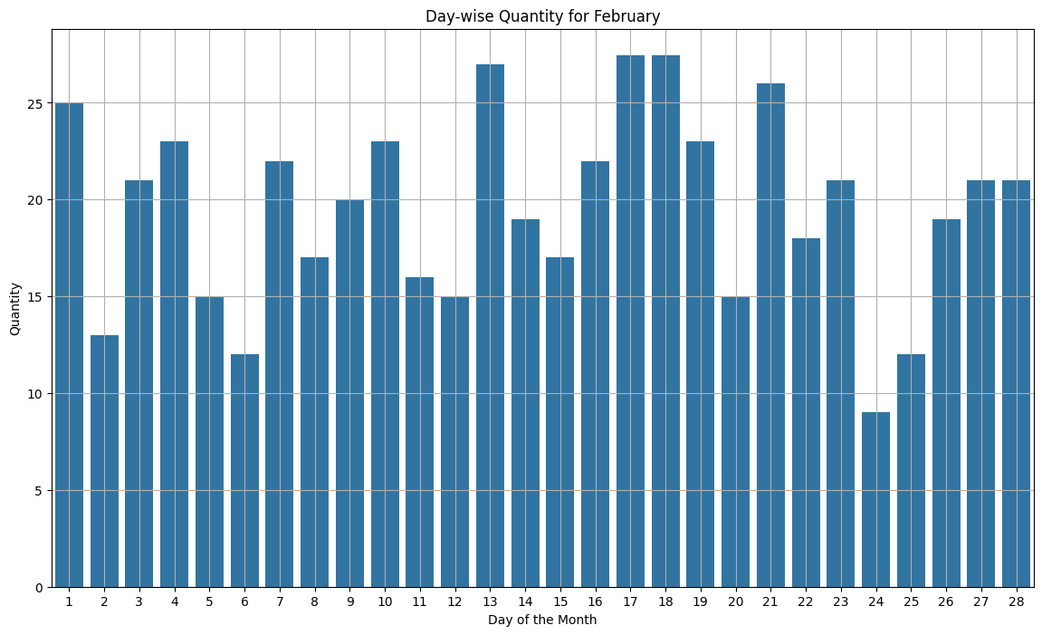
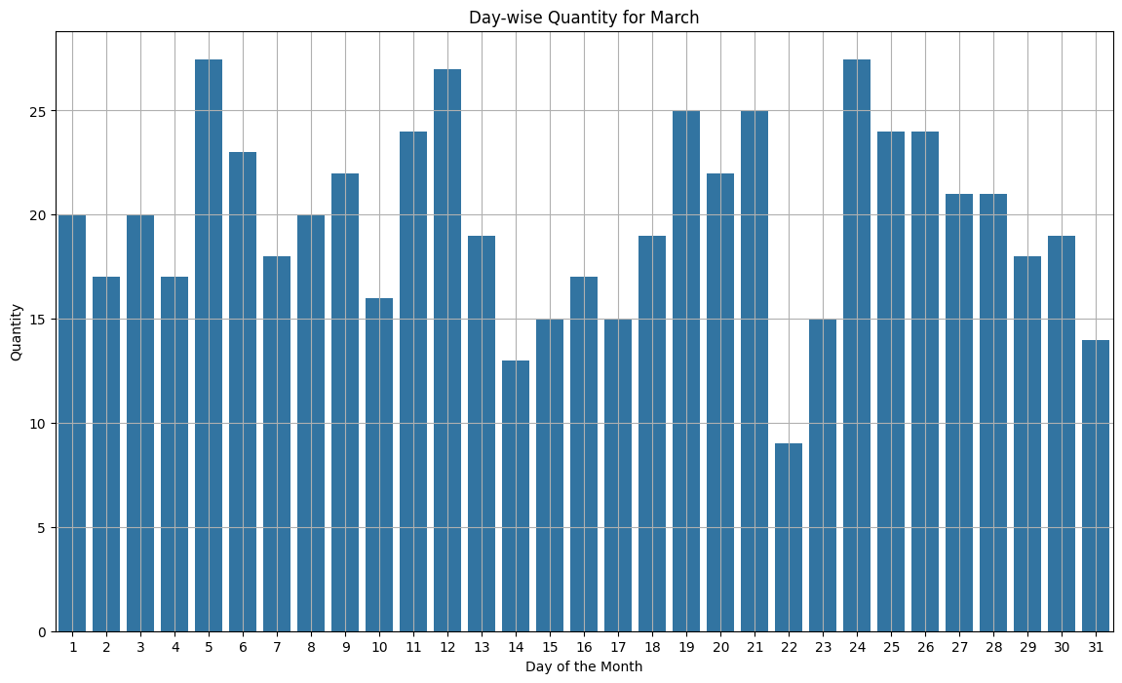
ELIXR
DAY WISE SALES

Slide 23
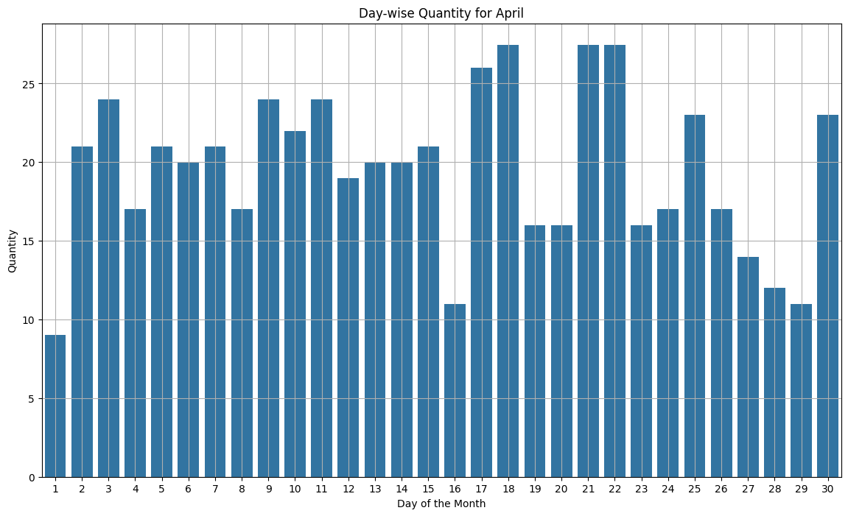
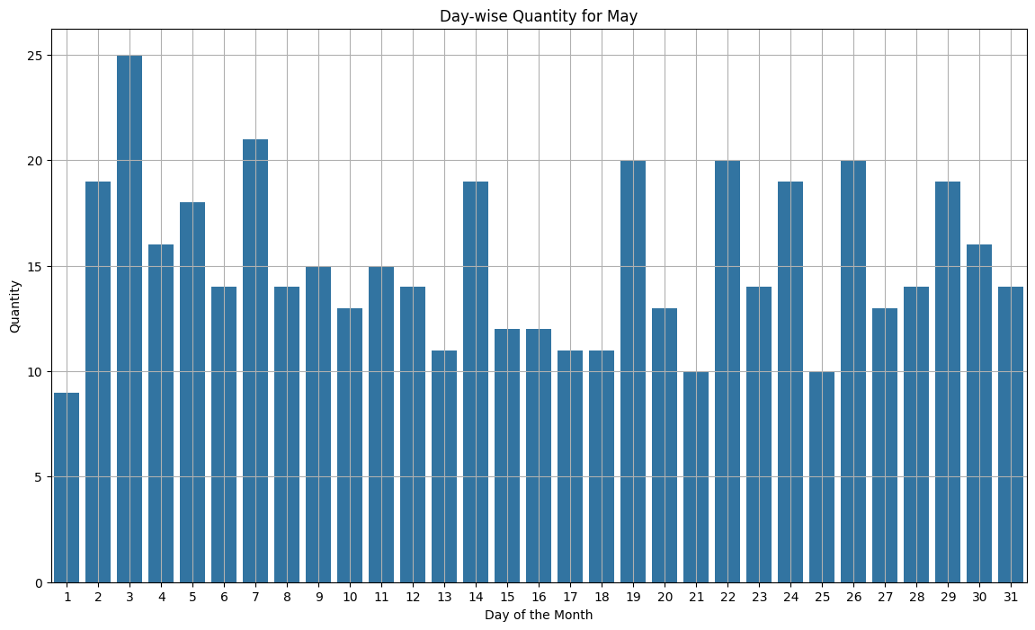
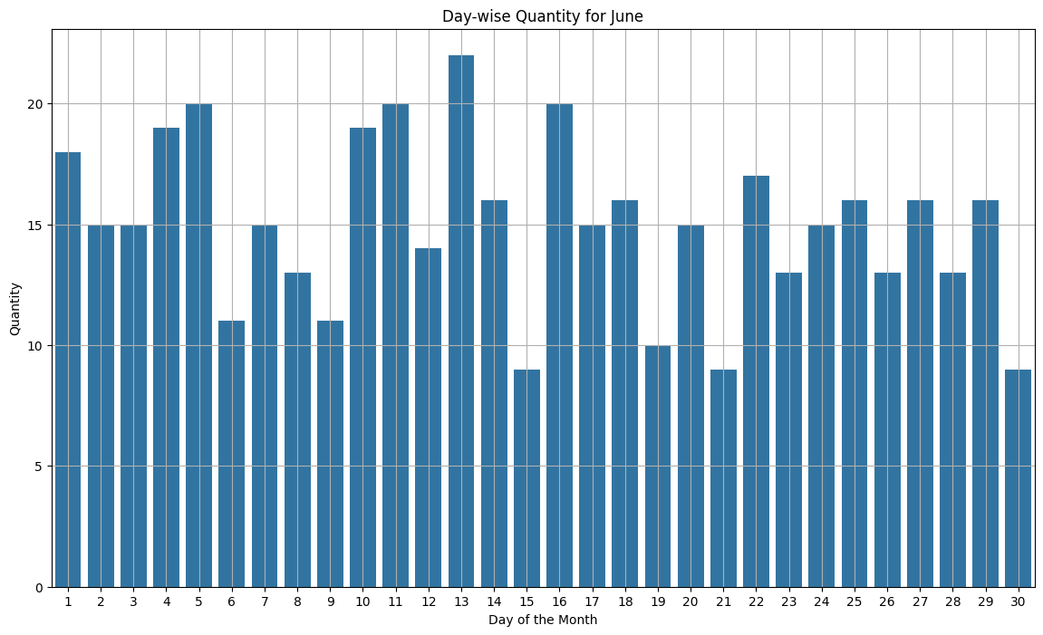
Sales on January 30, February 24, March 22, April 1, May 1, June 15, 21, and 30 did not exceed 10.
Sales recorded on December 5, 8, 10; January 2, 3, 24; February 13, 17, 18, 21; March 5, 12, 24; and April 17, 18, 21, 22 exceeded 25.

